Slide 1

Place and sensory learning

Slide 2
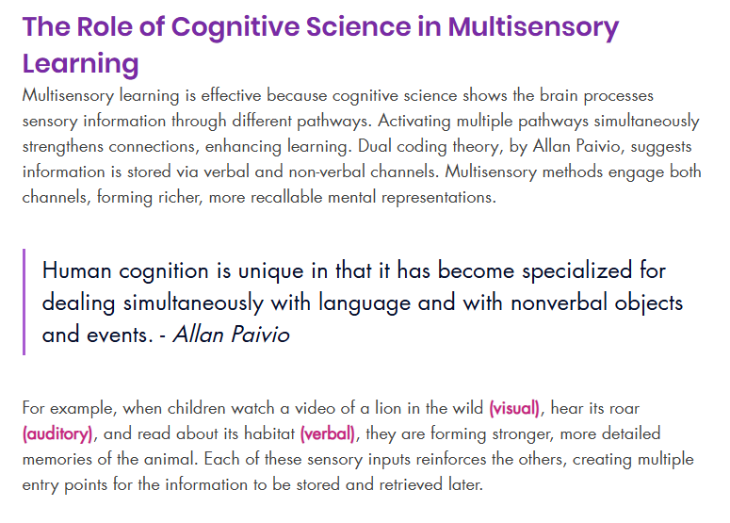
Source credit: https://www.learntoshine.co.uk/post/the-science-behind-multisensory-learning-why-it-works-for-kids

Slide 3
Why use a multi-sensory approach?
Enhances memory and recall
Recent neuroscience research demonstrates that multisensory learning creates richer mental representations. When more senses are involved in encoding information, learners build multiple pathways to retrieve that information later. For instance, if you learn a new concept by seeing a diagram, hearing an explanation, and drawing it out yourself, you're more likely to remember it when you need it, because you’ve created visual, auditory, and kinesthetic memory anchors.
https://www.dpag.ox.ac.uk/news/researchers-discover-why-multisensory-learning-is-beneficial-for-memory

Slide 4
Increases engagement
Passive learning, like watching a long webinar or reading dense text, can quickly lead to disengagement or fatigue. Multisensory learning, by contrast, naturally keeps the brain alert and active. When people engage physically (e.g., sketching a mind map or manipulating objects), visually (e.g., watching a video demo), or aurally (e.g., hearing a podcast while walking), the learning becomes more interactive and stimulating.
Even simple strategies like speaking concepts aloud, colour-coding notes, or building models out of real materials make the process feel less tedious and more dynamic.

Slide 5
Do you have a particular smell or sound that triggers a memory for you?
Think – Pair - Share

Slide 6
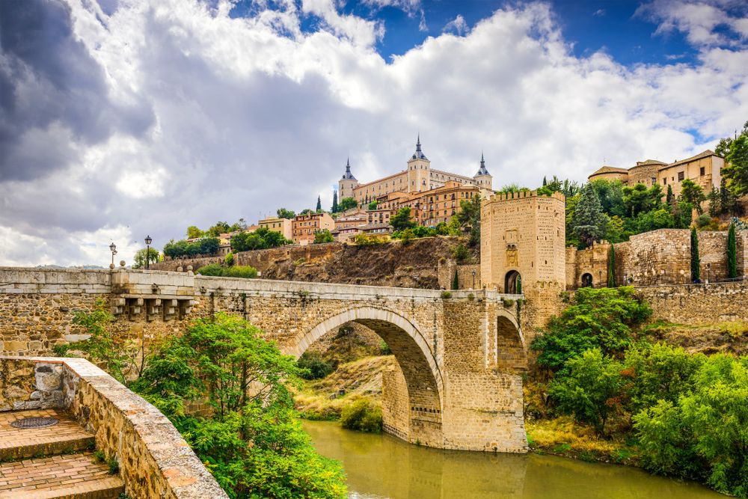
Toledo: City of three cultures

Slide 7
Roman Era: The city was founded by the Romans as Toletum in the 3rd century BC. It became a prosperous Roman colony, known for its trade in agricultural products and luxury goods.
Visigothic Kingdom: In the 5th century, the Visigoths conquered Toledo, making it the capital of their kingdom. During this period, the city became a center of Christian culture and learning.
Moorish Conquest: In the 8th century, the Moors conquered Toledo, incorporating it into the Al-Andalus Caliphate. Under Moorish rule, Toledo flourished as a cultural and intellectual centre, renowned for its architecture, poetry, and philosophy.
Christian Reconquest: In 1085, Christian forces led by King Alfonso VI of Castile recaptured Toledo from the Moors. The city became the capital of the Kingdom of Castile and León, and its cultural and economic importance continued to grow.
Golden Age: The 15th and 16th centuries marked Toledo’s Golden Age. The city’s architecture, art, and literature reached new heights, and it became a center of cultural and intellectual life in Spain.
Decline: In the 17th century, Toledo’s economic importance began to decline as trade routes shifted to other cities. However, the city retained its cultural heritage and historical significance.

Slide 8
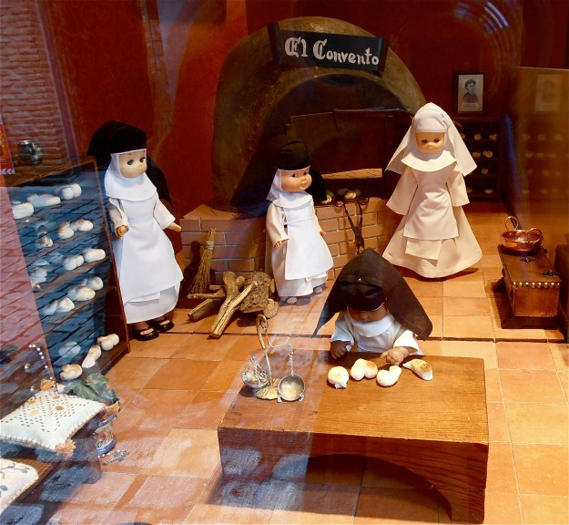
Can you predict what the story will be about?

Slide 9
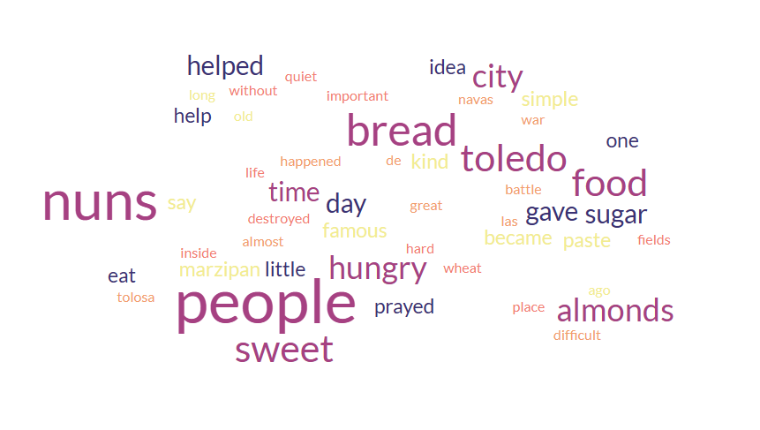
Word cloud

Slide 10
Listen to the story
If you want to, you can read along or you can just listen with your eyes closed.

Slide 11
The Sweet Bread of Toledo
A long time ago, in the old city of Toledo, there was a very difficult time. The people were hungry, and there was almost no food in the city.
This happened after the great Battle of Las Navas de Tolosa. The war had destroyed many fields, and there was no wheat to make bread. Bread was the most important food for the people, and without it, life was very hard.
Inside the city, there was a quiet place called the Convent of San Clemente. A group of nuns lived there. They prayed, worked, and helped the poor people of Toledo.
One day, the nuns saw that many people were weak and hungry. Children cried in the streets, and families had nothing to eat. The nuns wanted to help, but they also had very little food.
They looked in their kitchen and found only two things: almonds and sugar.
One of the older nuns had an idea. “Maybe we can make something with this,” she said.
The nuns took the almonds and crushed them into a fine powder. Then they mixed the almonds with sugar and a little water. Slowly, they made a soft, sweet paste.
They shaped the paste into small pieces and gave them to the hungry people.
At first, the people were surprised. “This is not bread,” they said.
But when they ate it, they felt stronger. The sweet almond food gave them energy. It was not the same as bread, but it helped them survive.
Day after day, the nuns continued to make this food. It became known as a kind of “sweet bread” for the people of Toledo.
Some people say the nuns created it because they were clever. Others say it was a gift from God, because they prayed for help.
In time, this simple mixture of almonds and sugar became famous. People gave it a name: mazapán, or marzipan.
Today, Toledo is still famous for its marzipan. Visitors from all over the world come to taste this sweet.
And when they eat it, they remember the story of the nuns who helped a hungry city with a simple and kind idea.

Slide 12
Read the story again
With your partner identify a gesture or movement for each paragraph.

Slide 13
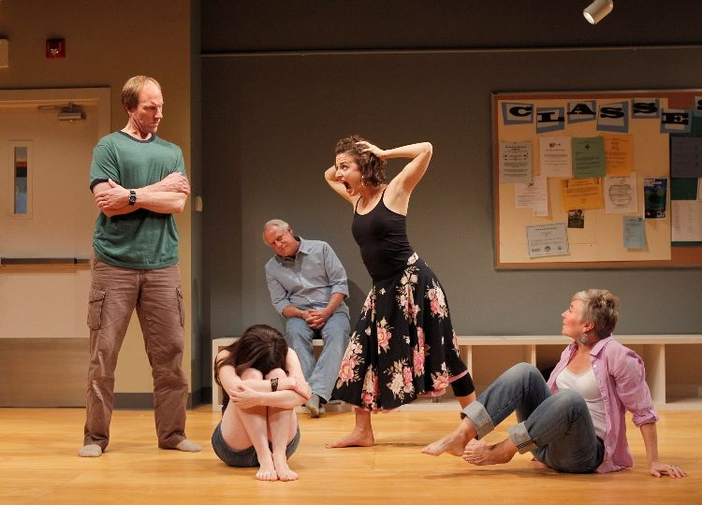
Tableau
You can tell a story using words, but we also tell stories using images.
Tableau is a theatre technique of telling a story in frozen pictures. Students use their body position and facial expression to portray a specific part of a story.
Notes:
This is a useful way to differentiate if you have shy students in your classes. Some students don’t want to ‘speak’ in front of people but everyone can be involved.

Slide 14
Marzapan time!
Hold the Marzipan – Take a piece of marzipan (or any food) in your hand. Feel its weight and notice how unusual it is to focus on it instead of automatically eating.
Observe the marzipan – Look closely as if seeing it for the first time. Pay attention to its crevices, wrinkles, and how light interacts with its surface.
Touch – Squeeze the marzipan between your fingers. Notice its texture and how it feels—does it have a lot of "give"? Is it dry?
Smell – Bring the marzipan to your nose and take a deep breath. Focus on its scent and allow it to occupy your full awareness.
Taste – Place the marzipan on your tongue without chewing immediately. Notice its sensation as you move it around your mouth.
Chew the marzipan – When ready, start chewing slowly. Take small bites and observe the textures and flavours that emerge as you break it apart, along with the saliva produced.
Swallow – Before swallowing, pause and notice the urge to do so. Then, swallow slowly, paying attention to the movement of the marzipan down your throat.
Reflect – After swallowing, consider how your mouth feels. Is there an aftertaste? Do you feel inclined to eat something else now that you've finished?
This exercise encourages mindfulness through focused observation and sensory engagement with food.

Slide 15
Which senses have we used when learning about the legend of Toledo’s marzipan?
*What crossover is there with 21st century learning skills, cooperative learning, UDL?

Slide 16
Contexts4Content
How have the field learning sessions contributed to your learning this week?

Slide 17
Place
Do you have a legend or myth from your town, city or country? Do you use this in your classes?
How often do you take learners out of the classroom?
What was the last excursion you were part of?
What challenges might teachers face when trying to incorporate ‘place’ into learning?
How could local environments be used to support your students’ learning?
How can digital tools help when incorporating place into learning?

Slide 18
Think of a lesson that you give regularly. How could you incorporate sensory learning or place?

Slide 19
Sensory overload
We also need to be aware that some learners can suffer from sensory overload; students with special educational needs and disabilities may have greater sensitivity to sensory stimuli. What works in one classroom won’t work for another, but some points to consider:
Reduce visual clutter
Minimise harsh lighting
Provide designated quiet zones
Comfortable seating options
Movement or quiet breaks

Slide 20
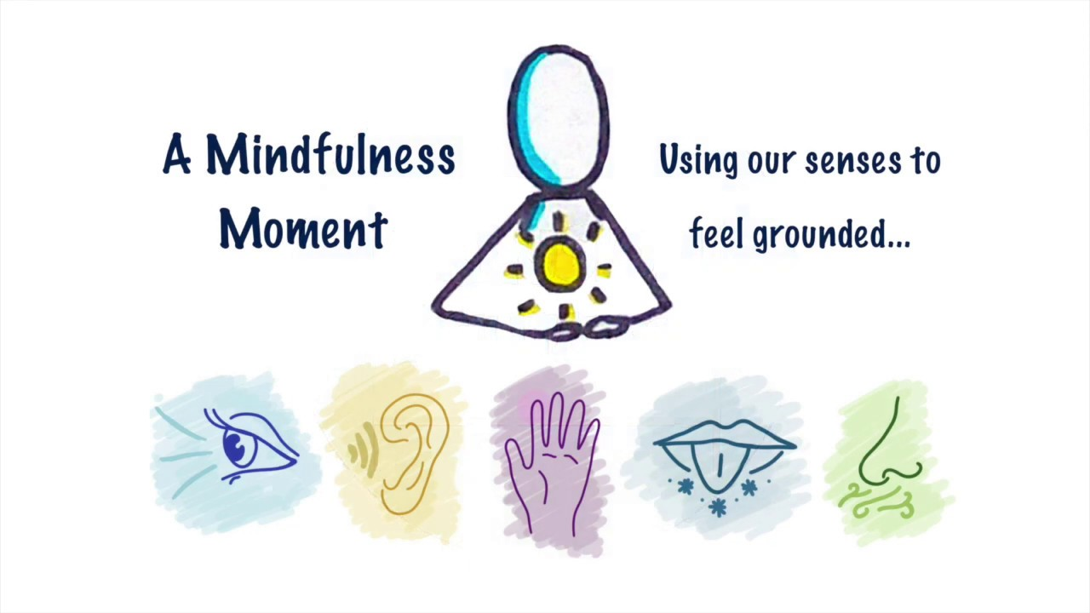

Slide 21
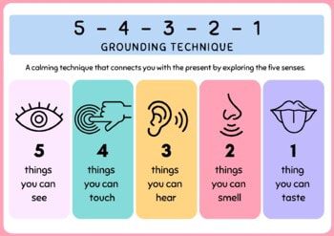
5-4-3-2-1 grounding technique
Pause
5 things you see
4 things you feel
3 sounds you hear
2 things you smell
1 thing you taste

Slide 22

Beach ball breathing
https://www.youtube.com/watch?v=ufL35GH74uU

Slide 23
Box breathing

Slide 24
A little mindfulness
When you’re in Toledo find a moment to practise the two techniques we have just gone done together. You might want to do this on your own or with the group.

Slide 25
Extra resources
https://www.youtube.com/watch?v=lyflpPbLIIs

Slide 26


www.englishmatters.org english@englishmatters.eu @EnglishMattersE www.facebook.com/englishmatters.org

